Slide 1

Sentiment Analysis on Social Media Posts with LSTM
Dr. Noha
Eng. Nawal

Slide 2

Team
Elsayed Elmandoh
205038
Somaya Yasser
205007
Nardeen Hesham
205074

Slide 3
关于公司
Project description

Slide 4
Project description
In this project, we aim to develop a Long Short-Term Memory (LSTM) model for sentiment analysis on text data extracted from social media posts, customer reviews, or news articles.
The sentiment analysis model will classify text into various sentiment classes, such as positive, negative, or neutral.

Slide 5
关于公司
Real-World Applications

Slide 6

Real-World Applications
Sentiment analysis is widely used in social media monitoring to understand public opinion and sentiment towards products, brands, or events.
It's employed in customer feedback analysis to gauge customer satisfaction and identify areas for improvement.
Sentiment analysis also plays a crucial role in market research, political analysis, and brand reputation management.

Slide 7
关于公司
Advantages of Project

Slide 8
Advantages of Project
Provides actionable insights: Sentiment analysis helps businesses and organizations make data-driven decisions based on customer feedback and public sentiment.
Scalable and efficient: With machine learning models like LSTM, sentiment analysis can be automated and scaled to analyze large volumes of text data.
Improves customer experience: By understanding customer sentiment, businesses can tailor their products, services, and marketing strategies to better meet customer needs and preferences.

Slide 9
关于公司
Apps that are similar

Slide 10
Apps that are similar
MonkeyLearn
This platform offers sentiment analysis tools using deep learning techniques like LSTM, it provides easy to use APIs and integrations to analyze social media posts.
Lexalytics
Lexalytics offers sentiment analysis solutions to analyze social media posts, reviews and other text data.
Aylien
Aylien provides text analysis APIs, including sentiment analysis that use deep learning models, their API can be integrates into various applications to analyze social media content.
Twinword
Twinword offers sentiment analysis APIs and tools that can analyze social media posts, they provide both cloud based APIs and on-premise solutions.

Slide 11
关于公司
Algorithms being used

Slide 12

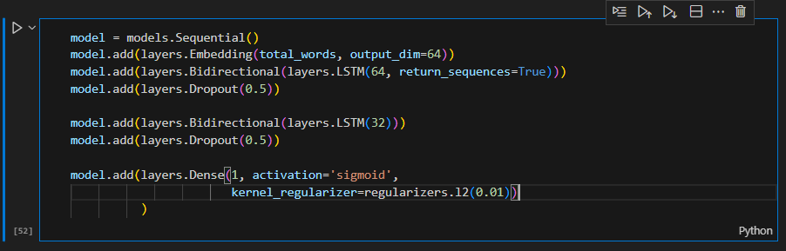
LSTM
Structure of LSTM

Slide 13
关于公司
Tools

Slide 14
Tools
Pandas
Read dataset
Matplotlib & Seaborn
Explore and Visualize data
NLTK
Apply preprocessing on data using Stropwords, PorterStemmer, WordNetLemmatizer and Word Tokenize
Tensorflow
Build LSTM model using models, layers and optimizers
Sklearn
Evaluate model using metrics such as accuracy score, classification report and confusion matrix

Slide 15
关于公司
Functions

Slide 16
Functions
Built-in functions in Python
Preprocess text series
Take dataset and return cleaned dataset

Slide 17
关于公司
Input/Output

Slide 18
Input
Sentiment140 dataset
The Sentiment140 dataset contains `1.6 million tweets` with 6 different sentiment classes: positive, negative, neutral, and three other classes.
Amazon Reviews dataset
The Amazon Reviews dataset contains 3.6 million reviews with binary sentiment classes: positive or negative.

Slide 19

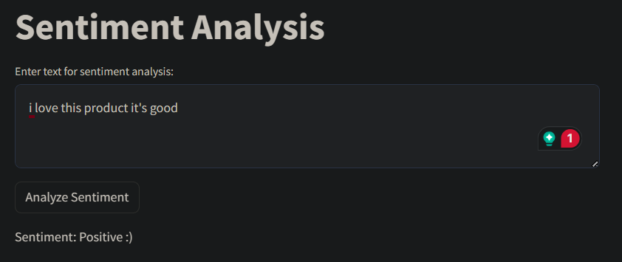
Output
Classes
Positive – Negative

Slide 20
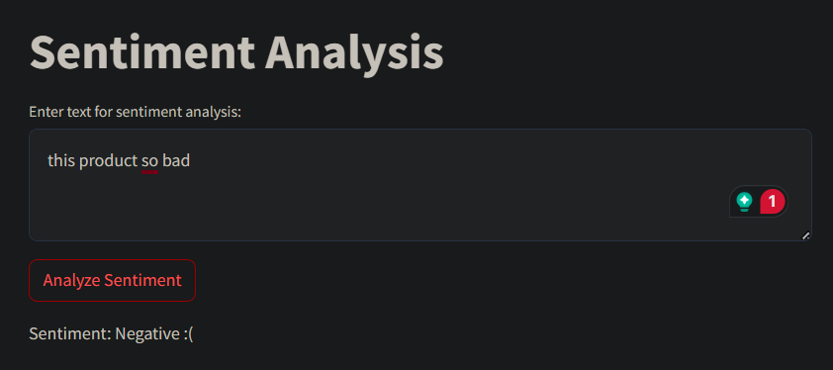
Output
Classes
Positive – Negative

Slide 21
关于公司
Evaluation

Slide 22
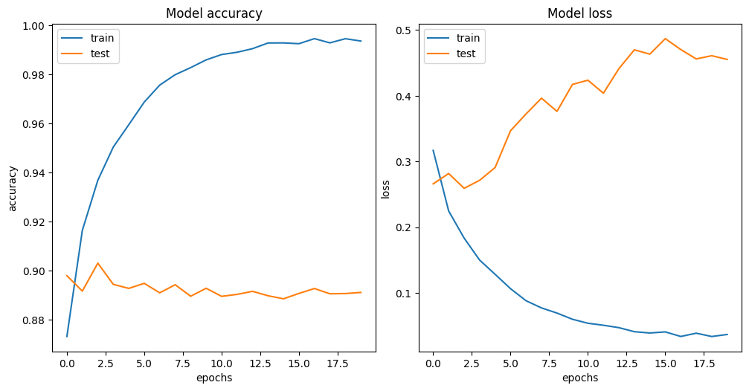
Model Accuracy
Model Loss

Slide 23
Metrics
89%
90%
90%
89%
Accuracy
Precision
Recall
F1-Score

Slide 24
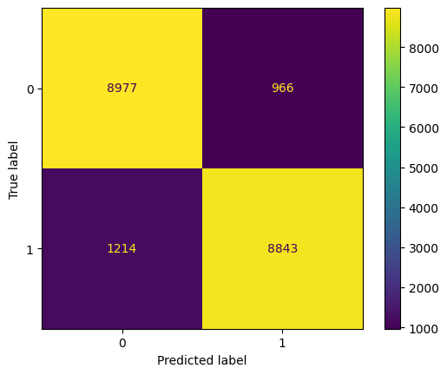
Confusion matrix

Slide 25
Thanks ☹

